Slide 1
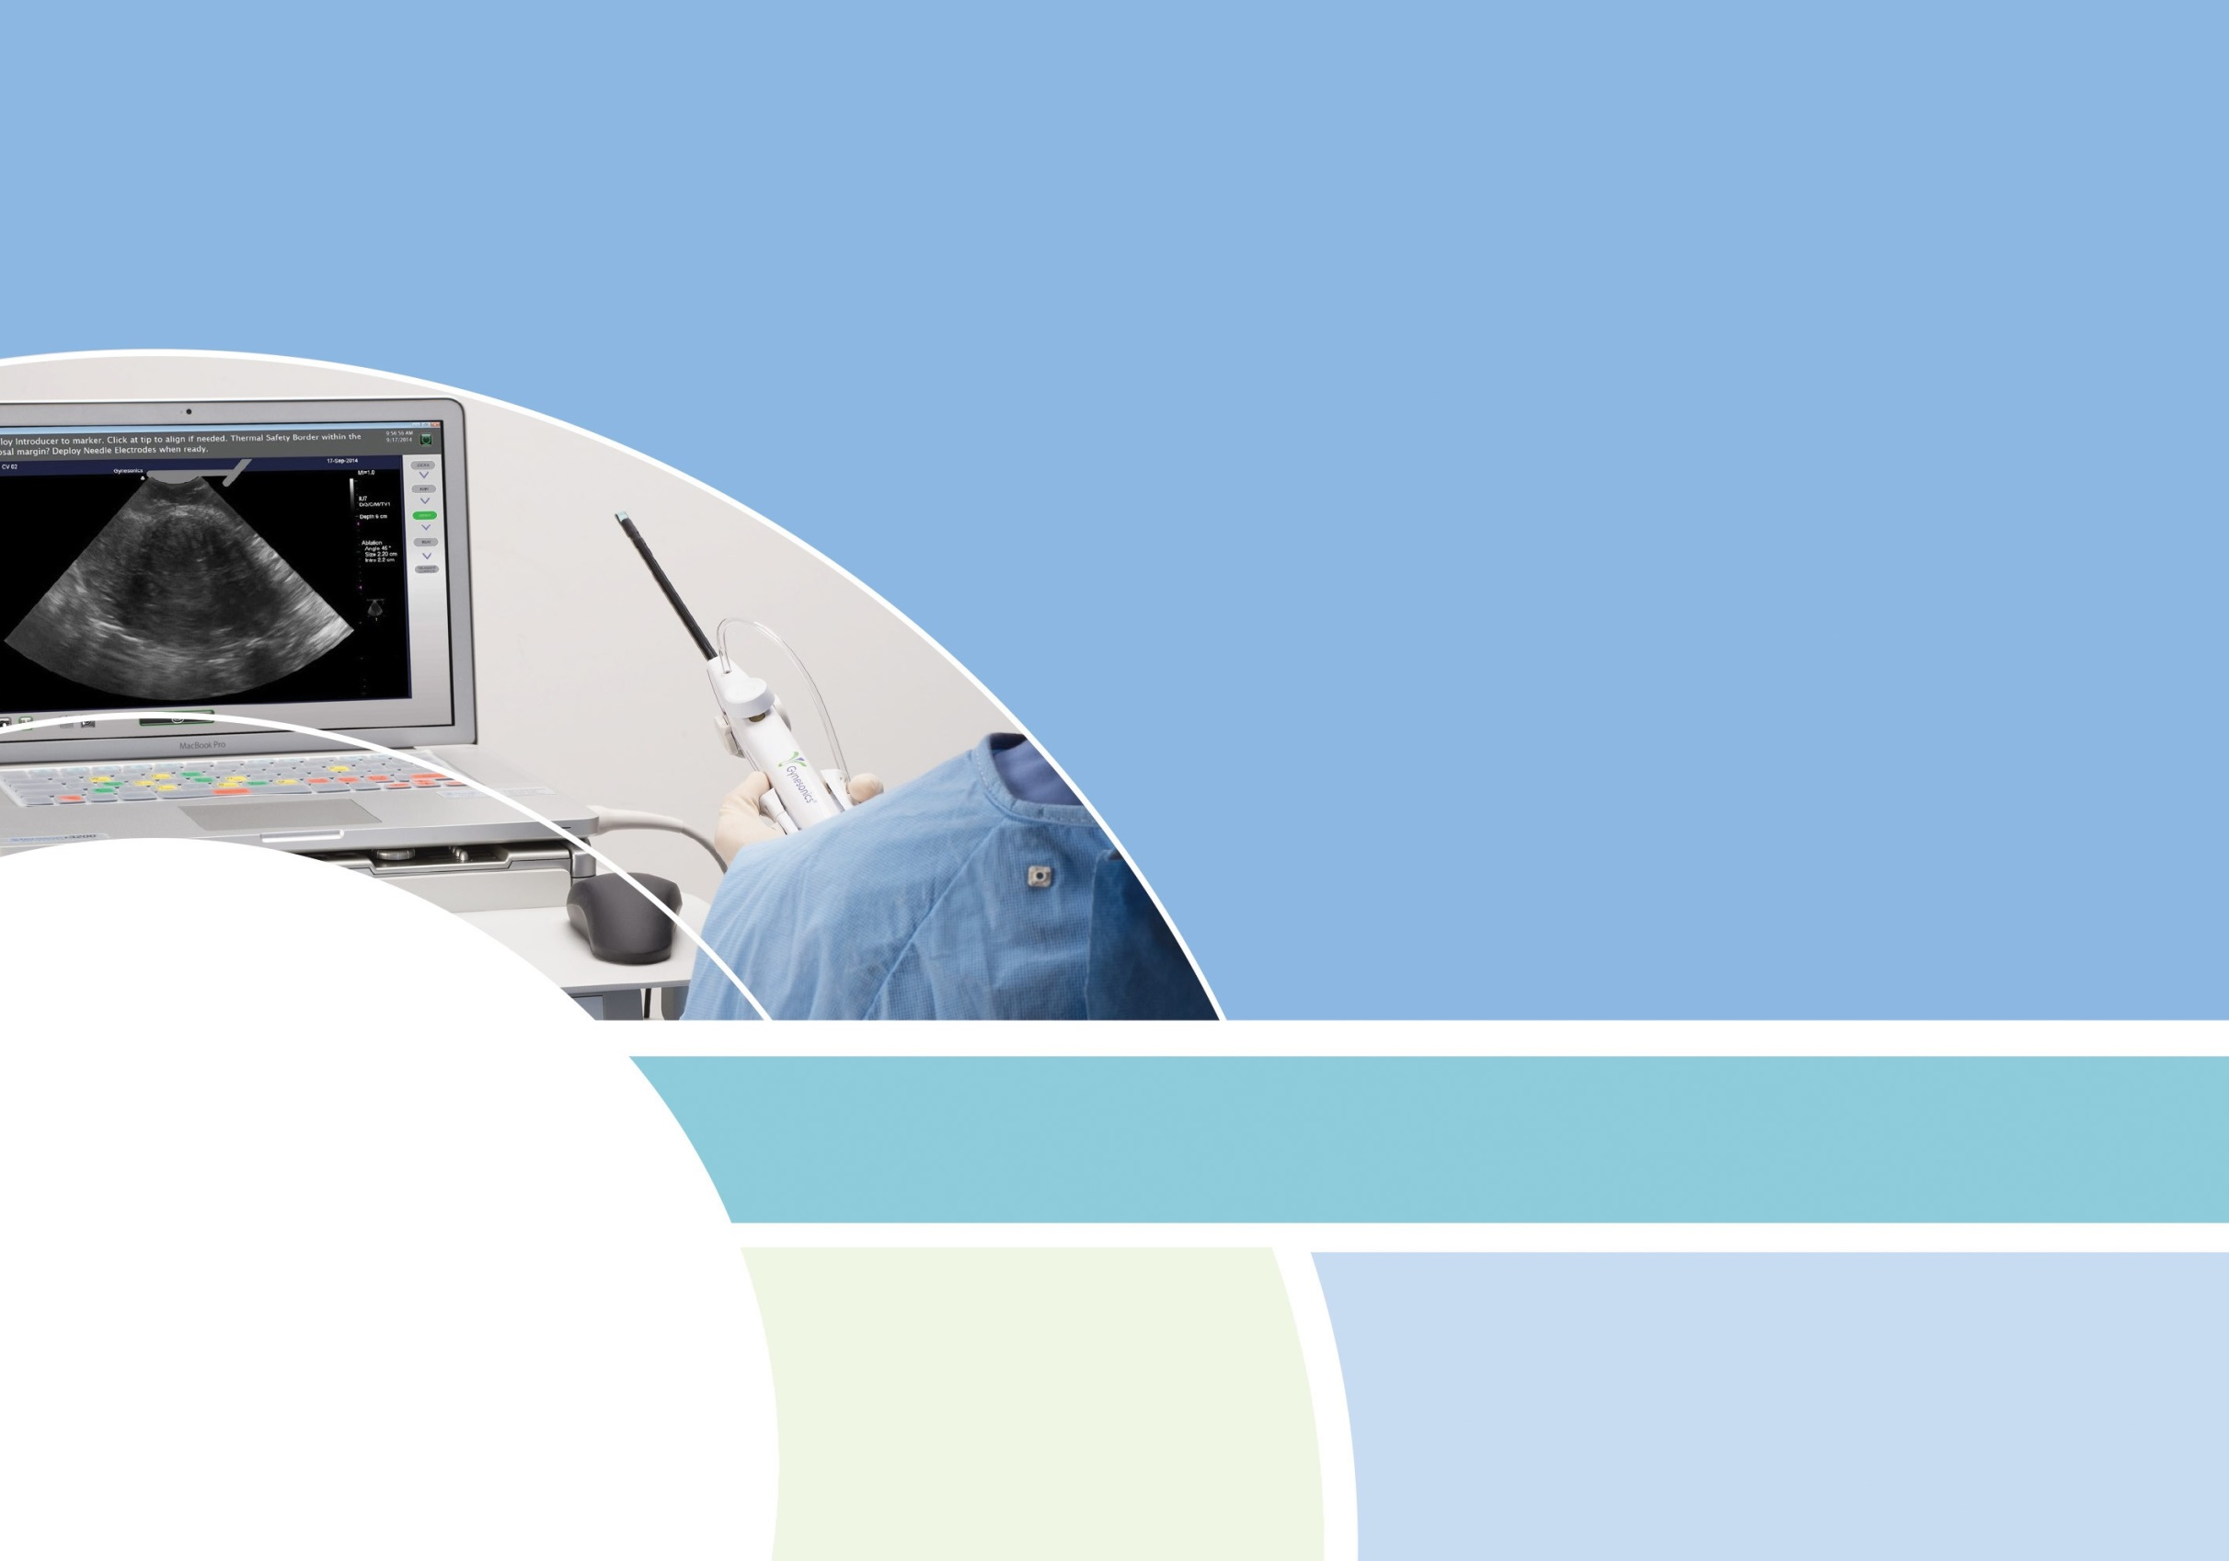



QUICK REFERENCE GUIDE
Sonata System for Sonography-Guided Transcervical Fibroid Ablation
Refer to the Sonata System Manual for complete operating instructions.
NON-STERILE PREP
STERILE PREP
DEVICE CONTROLS
POST PROCEDURE
TROUBLESHOOTING
SOFTWARE

Slide 2
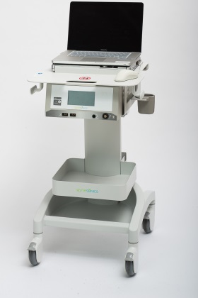
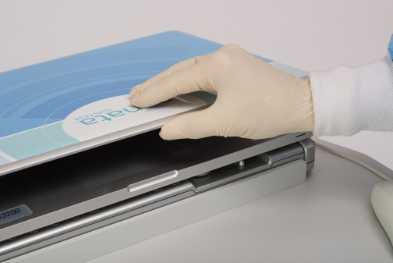
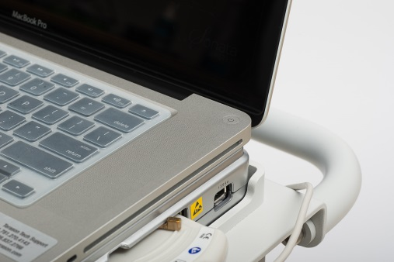
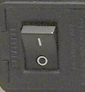
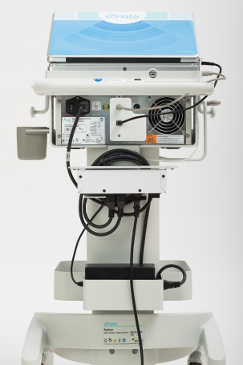
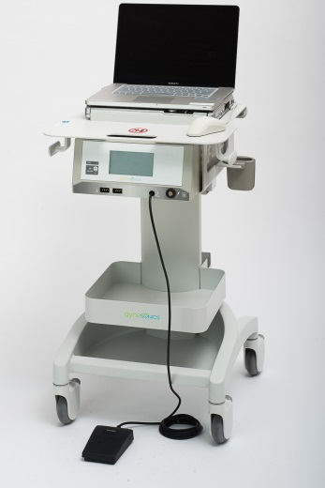
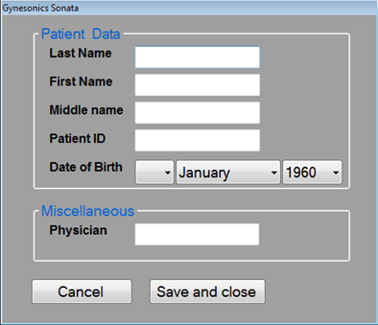

1
Position System Cart and Lock 2 Wheels
2
Open Ultrasound Console (laptop)
3
Power ON Ultrasound Console with Button
Lower System Cart to move into position.
Connect power supply.
Adjust cart height for viewing.
Lock at least 2 wheels.
4
Power ON RF Generator
5
Connect Footswitch
6
Enter Patient Data
Firmly connect pneumatic tube of Footswitch to RF Generator.
Login to Ultrasound Console.
Enter Patient Data to add to digital file.
Click “Save and close” button.
Turn on using switch on back of RF Generator.
continued >>
QUICK REFERENCE GUIDE | NON-STERILE PREP
NON-STERILE PREP

Slide 3
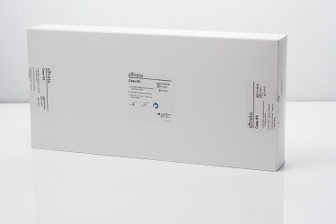
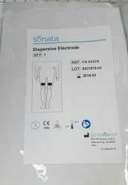
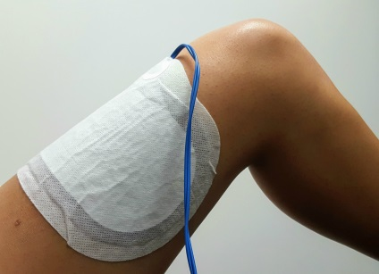
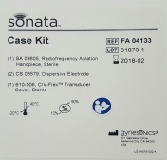
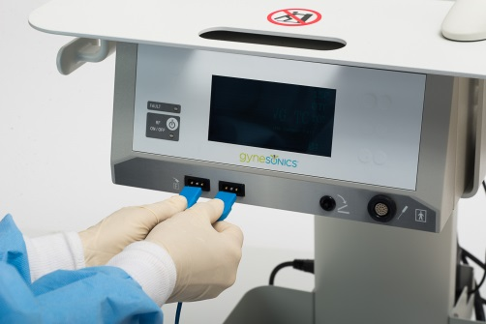
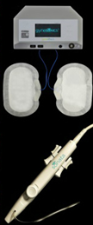
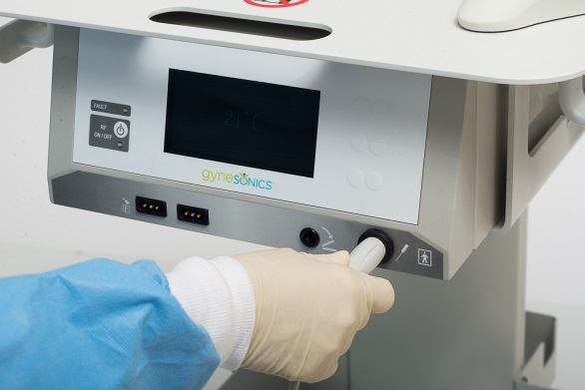
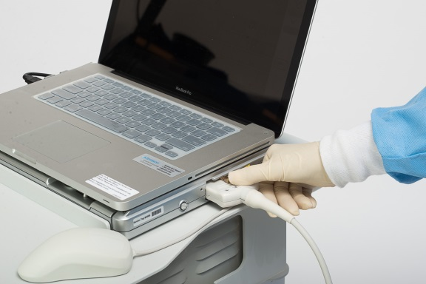
7
Open Sonata Case Kit
8
Apply Dispersive Electrodes
9
Connect Dispersive Electrode Cables
Check expiration date on kit and contents.
Remove both non-sterile Dispersive Electrodes from pouches.
Apply 1 per thigh.
Must have full contact with skin.
Direct cable toward knee.
10
Connect RFA Handpiece to RF Generator
11
Connect and Lock IUUS Probe to Ultrasound Console
12
Confirm Connections
Indicators blink when not properly connected.
Indicators will disappear from the display when all components are properly connected.
QUICK REFERENCE GUIDE | NON-STERILE PREP
NON-STERILE PREP

Slide 4
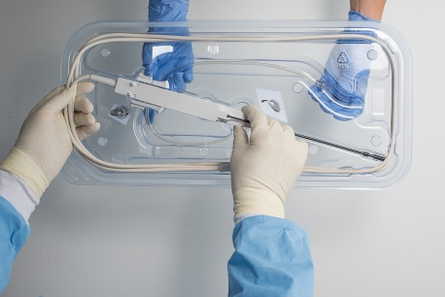
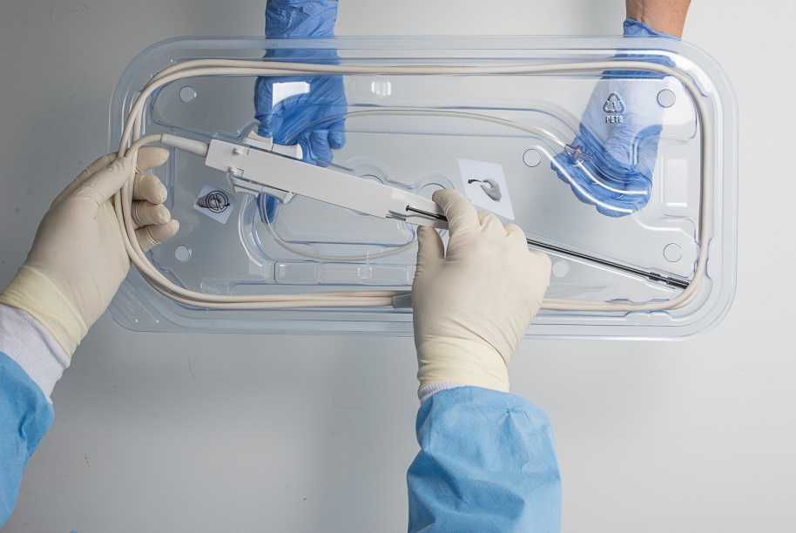
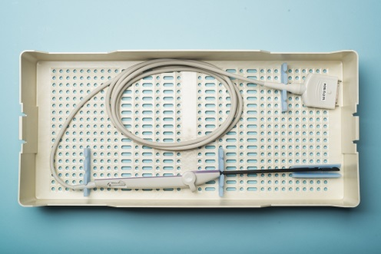
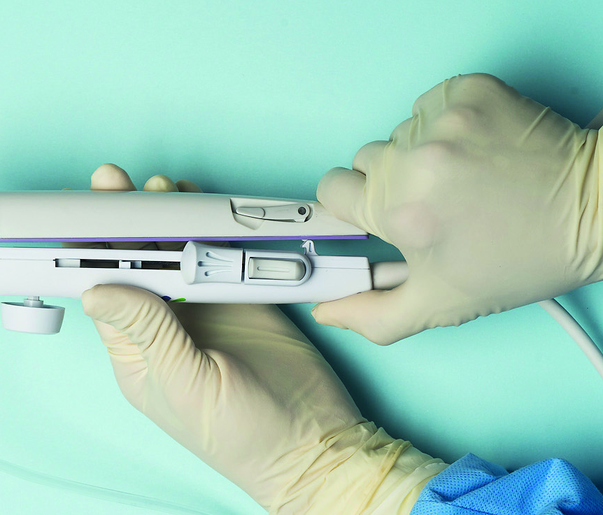
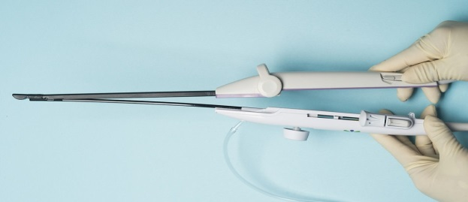
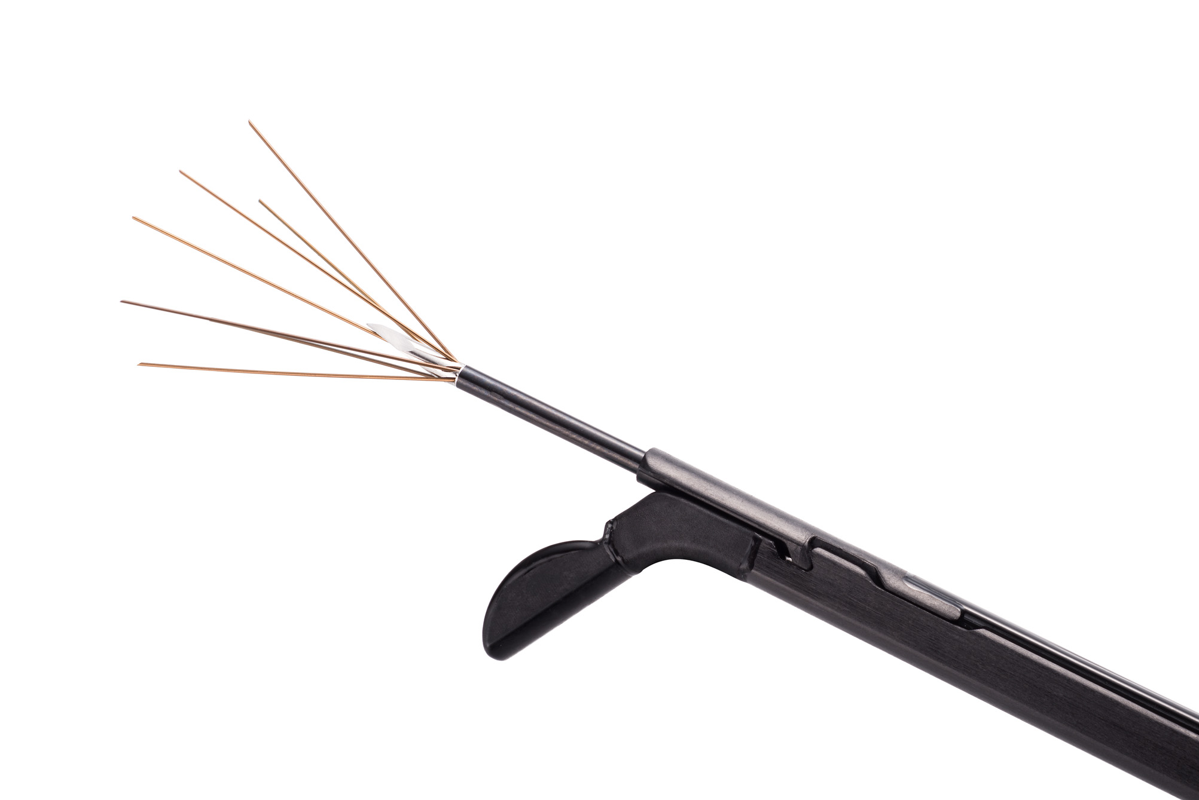
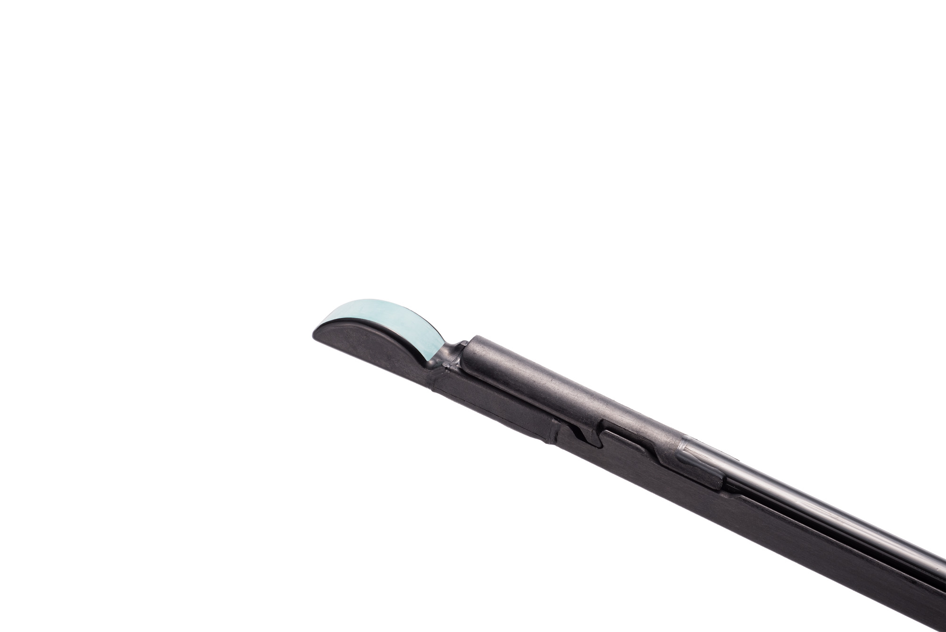
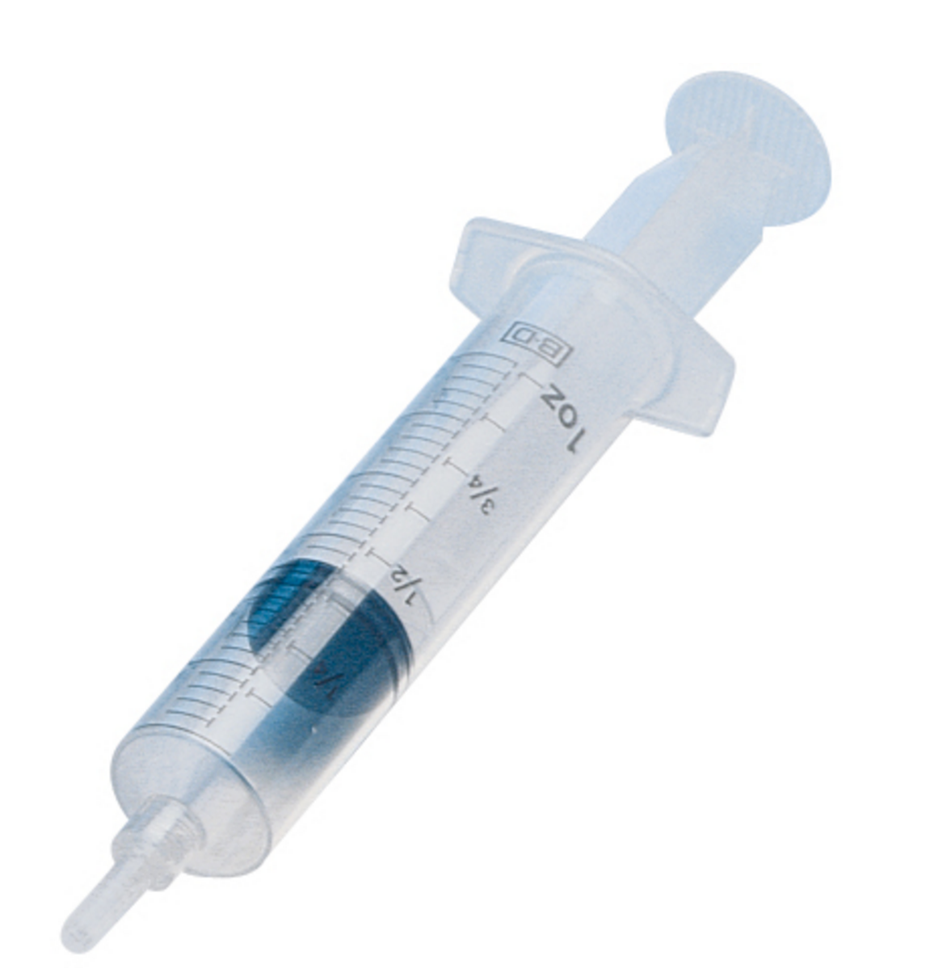
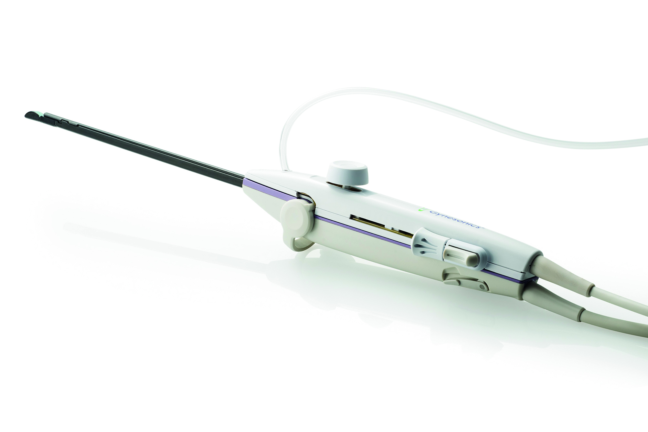
1
Prepare Draped Table with Required Supplies
2
Open RFA Handpiece
3
Open IUUS Probe
Place sterile IUUS Probe on draped table.
250 cc of Hypotonic fluid
2 sterile 60 cc syringes
Standard D&C Kit with dilators to 27 Fr (9mm)
New RFA Handpiece
Sterile IUUS Probe
Use sterile technique to remove RFA Handpiece from packaging.
Grasp from center to protect shaft.
4
Assemble Treatment Device
5
Inspect Treatment Device
6
Flush Treatment Device
Confirm that all controls are working.
Deploy Needle Electrodes and retract until Articulating Tip is back to 0°.
Remove air bubbles from syringe and connect to infusion port.
Flush Treatment Device with hypotonic fluid.
Connect tips of IUUS Probe to RFA Handpiece and snap handles together.
IUUS Probe
Verify tips are connected.
Needle Electrodes should be straight.
Return Articulating Tip to 0°.
RFA Handpiece
60cc syringe
QUICK REFERENCE GUIDE | STERILE PREP
STERILE PREP

Slide 5
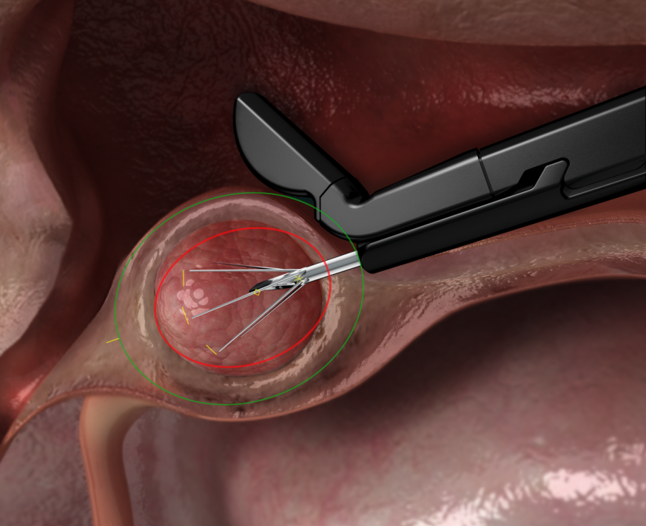
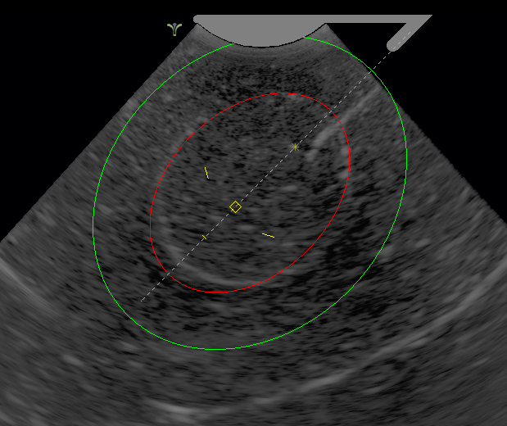
IUUS Probe Tip
Introducer Guide
Ablation Zone
↓
Needle Electrode Origin
Introducer Tip Marker
Thermal Safety Border
↓
Needle Electrode Tip Markers
The IUUS Probe Tip illustration at the top of the screen represents Tip angle (45° or 60°).
The Introducer Guide is a blue dashed line that indicates the path of Introducer deployment. -----
The Ablation Zone is indicated by the red inner ellipse and controlled with the Ablation Guide Knob.
The Thermal Safety Border is indicated by the green outer ellipse and controlled with the Ablation Guide Knob.
The Introducer Tip Marker is shaped like a yellow diamond  and the Needle Electrode Origin is shaped like a yellow star. ↓
The Needle Electrode Tip Markers are the 3 yellow lines that represent where the Needle Electrode tips will be positioned when deployed. The yellow lines turn red when the Needle Electrodes are fully deployed. – –
SMART Guide™| Setting Margins of Ablation in Real Time
DEVICE CONTROLS

Slide 6
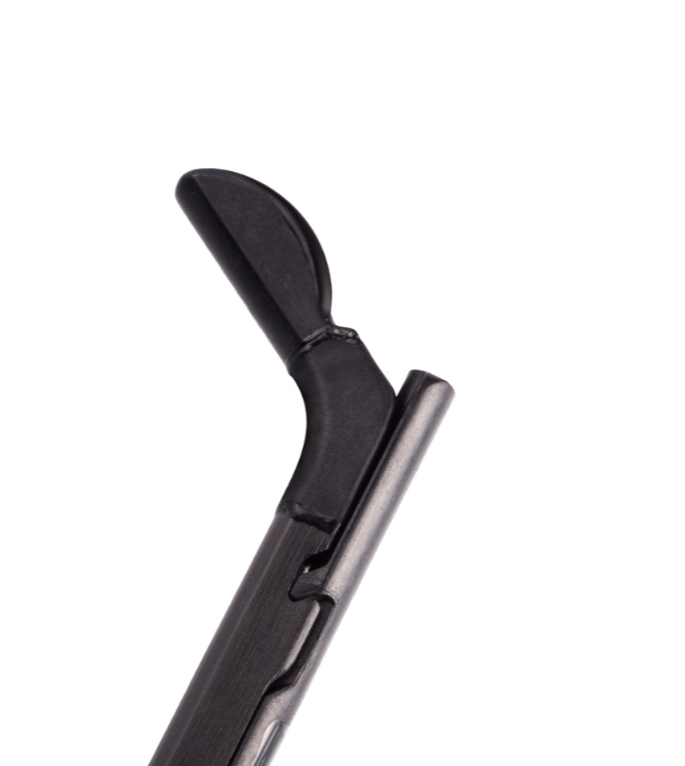
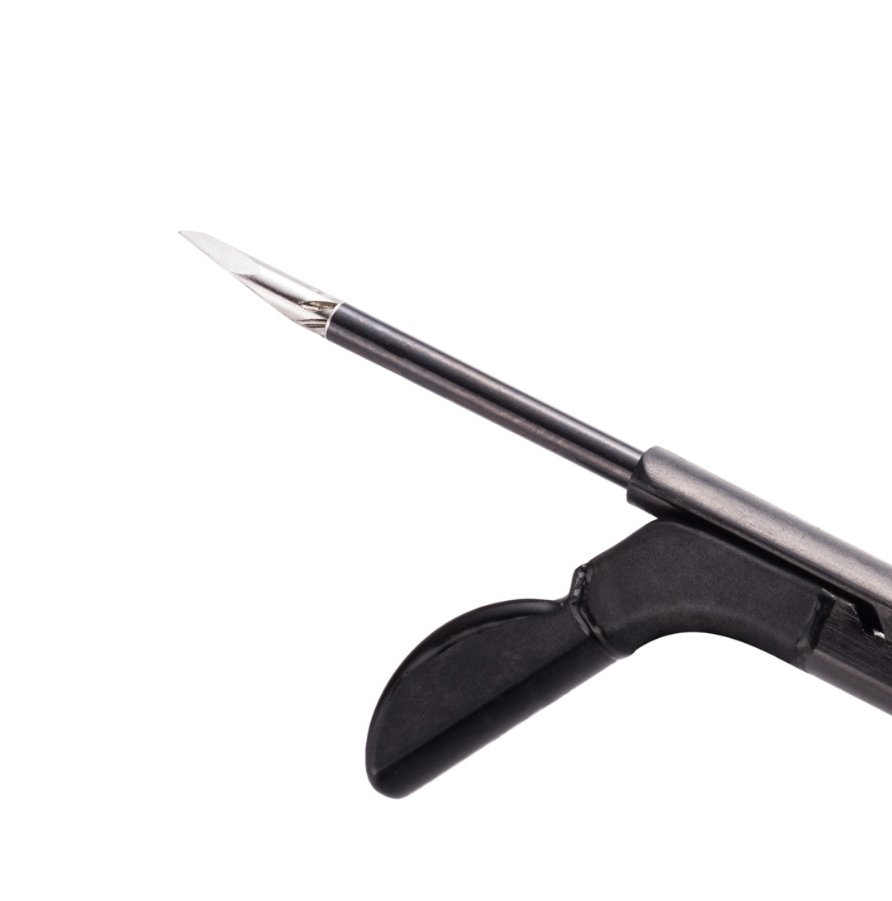
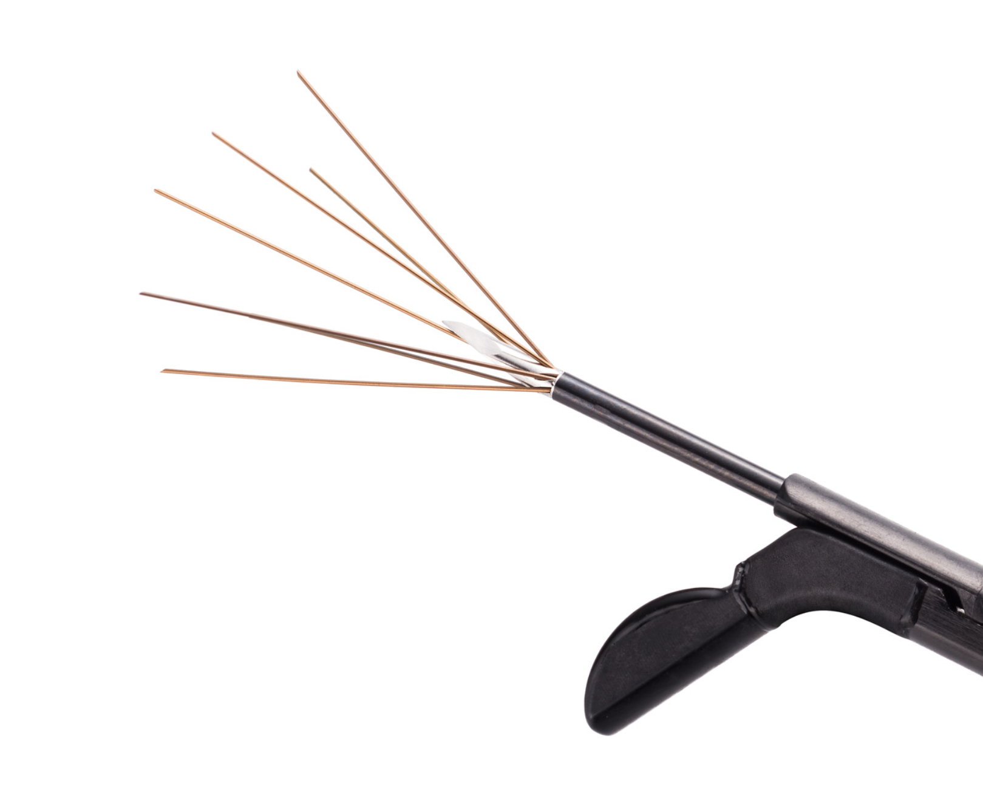
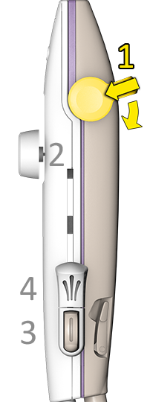
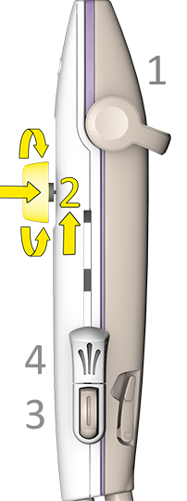
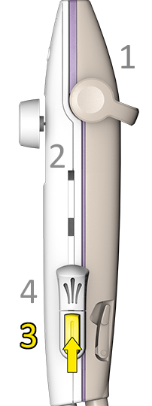
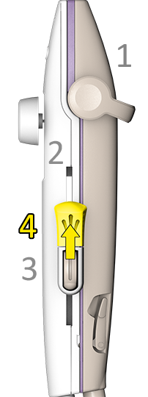
1
Depress Articulation Lever to Angle Tip
2
Depress, Slide, Rotate Ablation Guide Knob
3
Advance Introducer
4
Deploy Needle Electrodes
5
QUICK REFERENCE GUIDE | DEPLOY 1-2-3-4

Slide 7
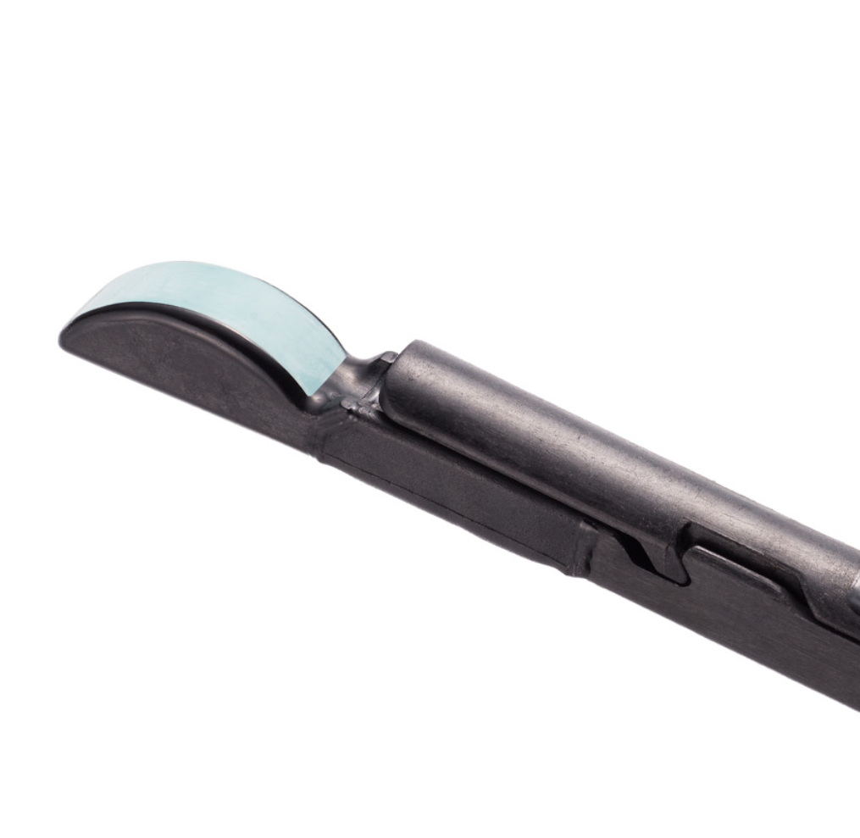
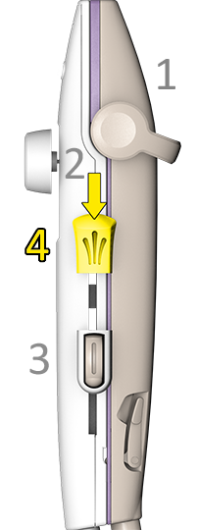
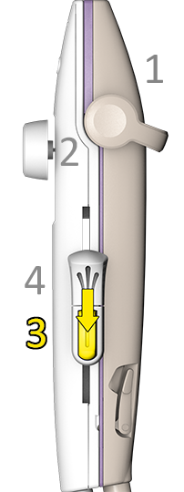
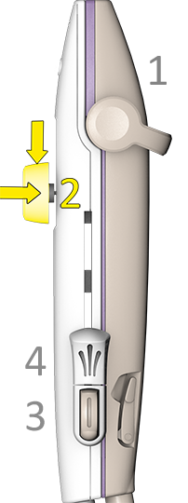
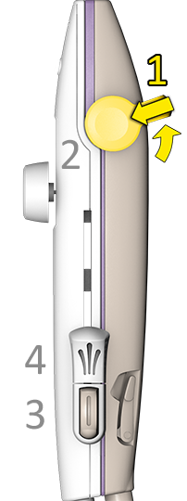
4
Retract Needle Electrodes
3
Retract Introducer
2
Depress and Return Ablation Guide Knob
1
Articulate Lever to Return Tip to 0°
QUICK REFERENCE GUIDE | RETRACT 4-3-2-1

Slide 8


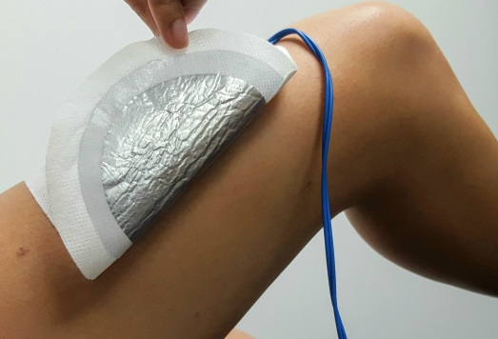
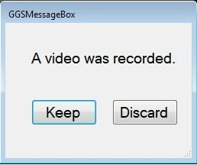


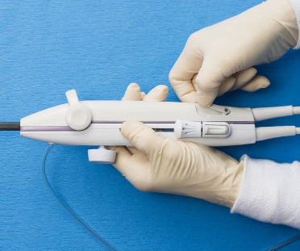
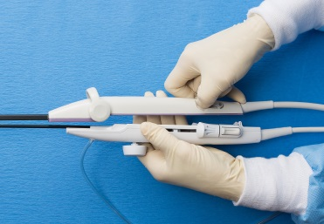
1
Disconnect Dispersive Electrodes
2
Remove Dispersive Electrodes & Check Skin
3
Disconnect, Clean, & Store Footswitch
Remove Footswitch.
Wipe with medical grade low alcohol disinfectant.
Store on System Cart.
Inspect skin surface for burns.
4
Disconnect RFA Handpiece & IUUS Probe
5
Manage Video Recording
6
Disassemble Treatment Device
Lift release latches simultaneously.
Click “Keep” to store video on hard drive.
Click “Discard” to permanently delete video.
Slide RFA Handpiece forward to separate.
RFA Handpiece
IUUS Probe
continued >>
QUICK REFERENCE GUIDE | POST PROCEDURE
POST PROCEDURE

Slide 9
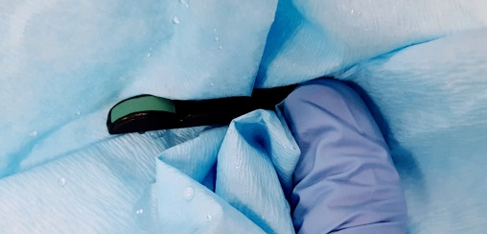
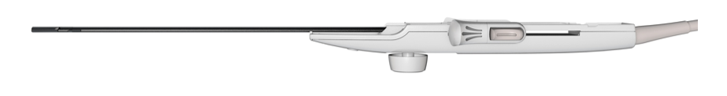

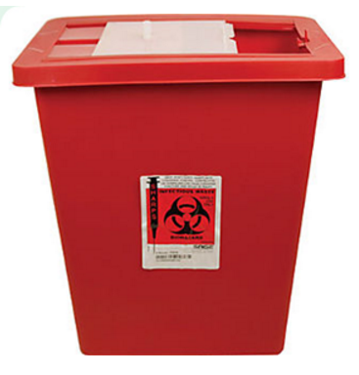
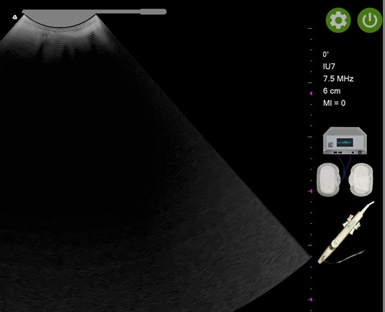
7
Pre-Clean IUUS Probe
8
Send IUUS Probe for Reprocessing
9
Dispose of RFA Handpiece
Dispose in Medical Hazard Sharps container.
Carefully remove visible soil from IUUS Probe imaging surface, shaft, handle, and cable.
Place in Reprocessing Tray to protect IUUS Probe Tip.
10
Power OFF Ultrasound Console with Power Icon
11
Power OFF RF Generator
12
Clean System Cart with Low Alcohol Disinfectant & Store
Wipe down cart with medical grade low alcohol disinfectant.
Unplug power cord.
Unlock wheels.
Lower completely prior to transport.
Use back handle to move.
Turn off using switch on back of RF Generator.
QUICK REFERENCE GUIDE | POST PROCEDURE

Slide 10
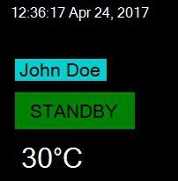
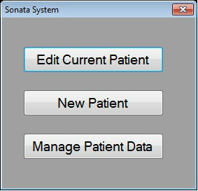
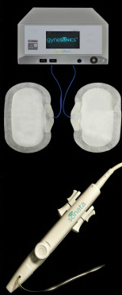



Problem | Troubleshooting
Unable to Enter New Patient Data | Click on the previously entered patient name. Choose “New Patient” button.
Component Connection Indicators are Blinking
If a Component Connection Indicator is blinking, check the connections of the component(s) displayed.
Dispersive Electrode Connections to RF Generator
RFA Handpiece Connection to RF Generator
Ultrasound Console Connection to RF Generator
QUICK REFERENCE GUIDE | TROUBLESHOOTING
TROUBLESHOOTING

Slide 11


Problem | Troubleshooting
When attempting to “Click on Tip” the arrow does not change to a “+”. (User hears an audible tone when clicking.) | The Introducer Tip is out of range. Retract Introducer Tip to align with Introducer Tip Marker .
 | Move System Cart to a different location. Change to a different wall outlet (isolated from other equipment). Make sure there is contact between tissue and IUUS Probe. Check the IUUS Probe cable is not wrapped around the System Cart or other electrical equipment.
+
✵
Electromagnetic Interference (EMI)
QUICK REFERENCE GUIDE | TROUBLESHOOTING

Slide 12

IUUS Probe Tip
Preferences
Power OFF
Time and Date
Patient Data
RF Generator Status
Articulation Angle
Ultrasound
Data Field
Component Connection
Indicators
Ultrasound Imaging Presets
Still Image Capture
Image Review
Freeze or Unfreeze
QUICK REFERENCE GUIDE | SOFTWARE CONTROLS
SOFTWARE

Slide 13



ICON/IMAGE | LABEL | HOW TO USE
 | Entering Patient Data for New Patients | The Patient Data window is displayed upon login, or following a procedure. To enter a new patient: Click on the patient name (e.g. Jane Doe). Click on the “New Patient” button. Enter patient data.
 | Component Connection Indicators | Components that are not connected will blink. Components that are connected will be solid. When all components are connected, the indicators will disappear.
 | Ultrasound Imaging Presets | The default Ultrasound Image Preset is for an average sized fibroid (the middle blue circle on the left side of the screen). The presets are programmed to adjust the image depth, ultrasound frequency, and other imaging parameters. To change to a preset, click on a circle (small, medium, or large).
QUICK REFERENCE GUIDE | SOFTWARE CONTROLS
QUICK REFERENCE GUIDE | SOFTWARE CONTROLS
SOFTWARE

Slide 14





ICON/IMAGE | LABEL | HOW TO USE
 | Freeze/Unfreeze | To freeze image, click on Freeze icon or the spacebar. Freeze Icon will remain gray while image is frozen. To unfreeze image, click on Freeze Icon or the spacebar.
 | IUUS Probe Articulation Angle | Articulation angle is displayed at the top of the ultrasound data field. The angles available are 0°, 45°, and 60°.
 | RF Status | Offline – RF not connected Standby – During targeting phase Ready – Ready to be activated by operator Active – Activated, heats Needle Electrodes to 105°C
 | Still Image Capture | To capture a still image, click on Still Image Capture icon.
 | Image Review | To review captured images, click on Image Review icon.
QUICK REFERENCE GUIDE | SOFTWARE CONTROLS

Slide 15





1
Disconnect RF Generator Cable from Top USB Port
2
Insert USB Drive Only in Top USB Port
3
Select “Manage Patient Data” Option
Always use a new USB drive or scan for viruses before inserting.
Window displays after clicking on the patient name or “Patient Data.”
4
Choose Files to Export to USB
5
Click “Copy Selected Patient Files”
6
Reconnect RF Generator Cable
Select Patient File(s) to be copied.
Click “Export to USB” button.
Remove USB Drive and make sure RF Generator cable is reconnected.
QUICK REFERENCE GUIDE | MANAGE FILES

Slide 16


Gynesonics, Inc. 301 Galveston Drive Redwood City, CA 94063 Telephone: +1-650-216-3860 www.gynesonics.com | Gynesonics Netherlands BV Kapershof 46 6641 JS Beuningen The Netherlands Phone: +31 24 6750555
The Sonata System is intended for diagnostic intrauterine imaging, and transcervical treatment of symptomatic uterine fibroids, including those associated with heavy menstrual bleeding. For full prescribing information, contraindications, patient selection criteria, and safety information, refer to the Sonata System Manual or visit www.gynesonics.com/sonata-system. SMART is a trademark and Sonata is a registered trademark of Gynesonics, Inc. © 2017 Gynesonics, Inc. LS 05309 Rev 02 September 2017
0086

